Slide 1

SRI CHANDRASEKHARENDRA SARASWATHI VISWA MAHAVIDHYALAYA
(Deemed to be university u/s 3 of UGC act 1956) (Accredited with “A” by NAAC)
Enathur, Kanchipuram – 631561. Tamilnadu www.kanchiuniv.ac.in
Creative and Innovative Project (CIP)
SCULPTURE MANAGEMENT SYSTEM
11209A020
VEMPARALA VENKATA SURYA
11209M001
ARAVIND S
Guided By
MR .V. BALU
ASSISTANT PROFESSER
Dept. of CSE
Review Date :24/05/2023

Slide 2
Contents
Introduction
Abstract
Objective
Existing system and its drawbacks
Proposed system and Advantages
Database design
Architecture diagram
Project description
Module description
Implementation and Methodology
Result
Conclusion
*

Slide 3
Introduction
Image retrieval is the process of browsing, searching and retrieving images from a large database of digital images. The collection of images in the web are growing larger and becoming more diverse .Retrieving images from such large collections is a challenging problem. One of the main problems they highlighted was the difficulty of locating a desired image in a large and varied collection. While it is perfectly possible to identify a desired image from a small collection simply by browsing, more effective techniques are needed with collections containing thousands of items. To search for images, a user may provide query terms such as keyword, image file/link, or click on some image, and the system will return images "similar" to the query.
*

Slide 4
Abstract
In this project, developed a system as a search engine for find the temple sculpture details. Using this system we can upload the details of sculpture,while i=u the system will provide the entire sculpture details like name of the sculpture, temple name, state and city of the temple. Once the image is uploaded into the database
*

Slide 5
LANGUAGE USED HTML – Web pages and user interface.
NODEJS - server side connection
MYSQL – database schema
*

Slide 6
Existing System
In existing there is no proper system for searching of temple sculptures details. If we want to search for some temple sculpture on the web, only the image is displayed to the user. It doesn’t display any relevant details of the image that we searched
*

Slide 7
Proposed System .
This Application helps to fine the temple sculpture details using the images. The theft of sculptures had done in any one found sculpture they don’t know details of sculpture to which they have to handover the sculpture. This Application helps to find the temple sculpture details using the search engine. The theft of sculptures had done in any one found sculpture they don’t know details of sculpture to which they have to handover the sculpture. The architecture we used to develop this project is mentioned as below in different forms
ADVANTAGES OF PROPOSED SYSTEM:
Efficiency and Effectiveness
It provide quick response with very accurate information
Mainly used for the police department
If any sculpture theft then retrieve the information about the sculpture is very easy
*

Slide 8
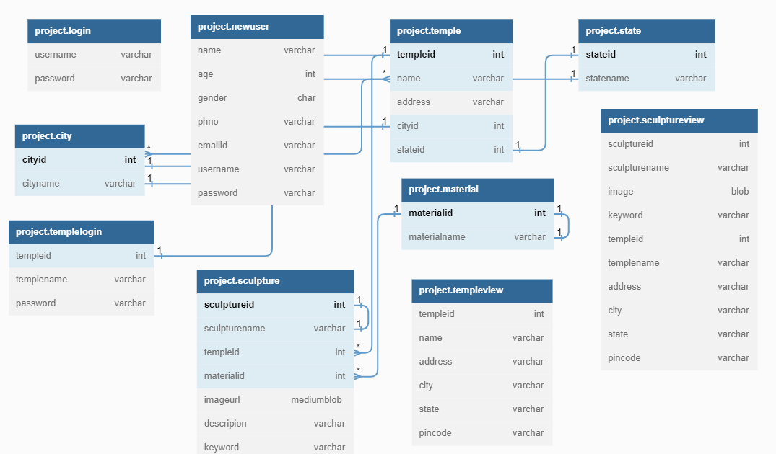
DATABASE DESIGN
8

Slide 9
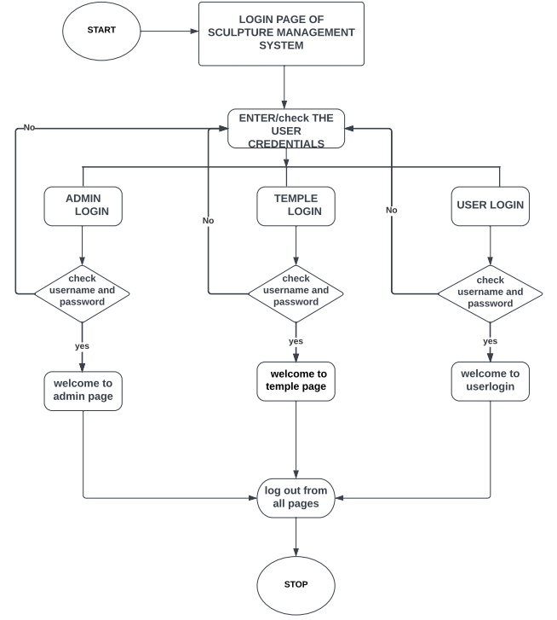
ARCHITECTURE DIAGRAM
9

Slide 10
Project description
The Sculpture Management System is a web application designed to provide an efficient and organized system for managing sculptures. The system allows authorized personnel to access and update information related to sculptures.
The system provides a user-friendly interface for managing the details of sculptures and temples, including adding new temples, adding sculptures to existing temples, and updating and deleting existing temple and sculpture details. Users can also search for sculptures and temples by keyword, and view details about individual sculptures and temples.
If a sculpture has been stolen, the police department may need to gather information about the sculpture to aid in their investigation. This could include details such as the sculpture's ID, name, material, image, description, and keywords. Additionally, information about the location and time of the theft may also be important.
With a sculpture management console, the police department could easily access this information from a centralized database. They could search for a specific sculpture using its ID or name, or generate reports on sculptures that match certain criteria, such as sculptures made from a specific material or sculptures located in a certain city.

Slide 11
Having this information readily available can help the police department quickly identify stolen sculptures, track them down, and return them to their rightful owners. It can also help prevent future thefts by enabling better tracking and monitoring of sculptures in public spaces.
The system stores details about temples, including the temple ID, name, address, city, state, and pincode. For each temple, the system can store multiple sculptures, with details including the sculpture ID, name, material used, an image of the sculpture, a description of the sculpture, and keywords to help with searching and filtering.
In addition, the system provides reporting functionality, allowing users to generate reports based on the information in the database. Reports can be generated based on various criteria, such as by temple or sculpture, or by city or state. Reports can be exported in various formats, such as PDF or CSV, for further analysis and processing.

Slide 12
MODULE DESCRIPTION
The Sculpture Management System is an application designed to manage the details of sculptures in a collection or exhibition. This system contains three modules describe as follow
Administrator module
Temple module
Guest module
Administrator Module: Administrator has a full authority to maintain the system with database. The Admin can login through adminlogin .The main functions of the administrator
Add temple : Admin can add details about temple and assign one id for each temple . In this contain templeid ,name, address ,city ,state , pincode
Add sculpture: Admin has accesses to add sculpture .It contain sculptureid ,sculpturename ,templeid ,templename ,image ,description ,keyword.
.
Add TempleLogin : Admin has only accesses to add Templelogin for particular temple .In this templeid, templename, username ,password.
Add Material : Admin has to add any new material of the image required he has the authority to add material and assign one id to the material
Add City : Admin has accesses to assign id for the city with the help of the id city can be acessesable

Slide 13
Temple Login: In the temple Login he/she has the authorithy to accesses only temple page .In this module templelogin user can add sculpture related to that particular temple only
Add Sculpture : Templeadmin has accesses to add sculpture . It contain sculptureid, sculpturename
templeid, templename, image, description, keyword.
Here temple admin has authorithy to add multiple sculptures for a specific temple by linking them to the corresponding temple ID.
User Login: This module provides user authentication mechanism User has to register with his details and then user gets the approval from admin then only the user will access the application. Main function of users are search .
Search : In this search option user can search according to the keyword , state.
This helps user to fetch the detail about temple sculpture easy for the police department in case of any theft happens

Slide 14
Methodology A sculpture management system is a software system designed to help manage and organize sculptures in a collection or exhibition. The methodology for developing a sculpture management system. Requirements gathering: Identify the specific search criteria they need to find sculptures, such as the source of the sculpture (e.g., temple), the material used, and state selection relevant to the collection. Determine how the search results are displayed. Design: Based on the requirements gathered, design the search engine module's architecture and user interface. The system should include modules for search query entry, filtering and sorting of results, and displaying detailed sculpture information. Implementation: Develop the search engine module according to the design. This may involve selecting and configuring a search engine platform, creating the user interface, and developing the necessary backend components. Integration: Integrate the search engine module with the sculpture management system to ensure that it can access the necessary data. Test the module to ensure that it meets the requirements and that the search results are accurate and relevant. Maintenance: Provide ongoing maintenance and support for the search engine module. This may involve fixing bugs, optimizing search performance, and updating the module to meet changing requirements.

Slide 15
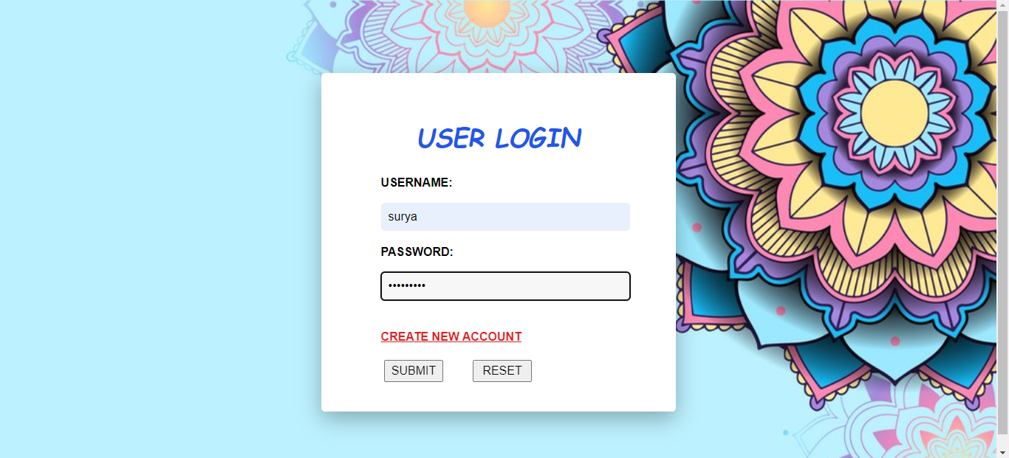
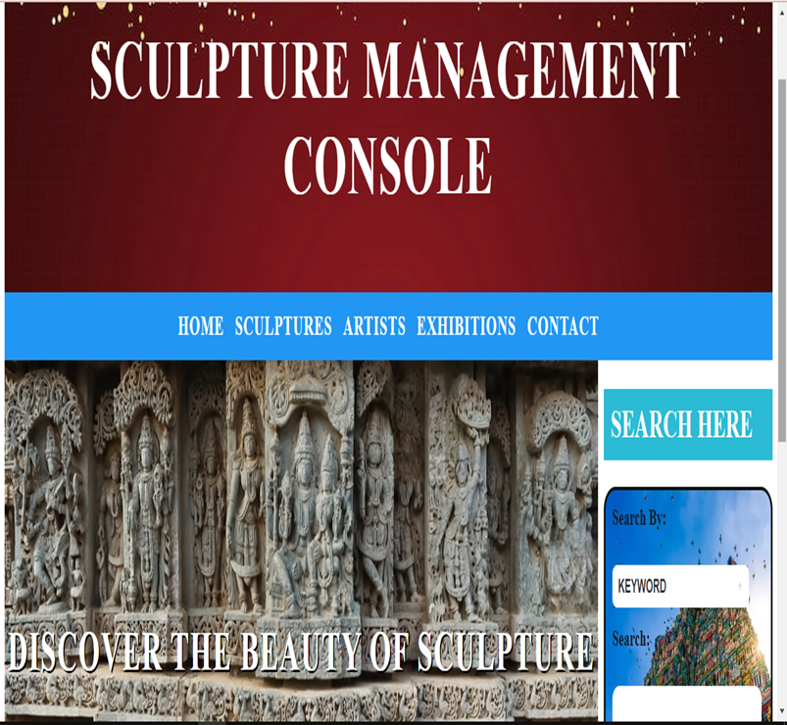
Results
*

Slide 16
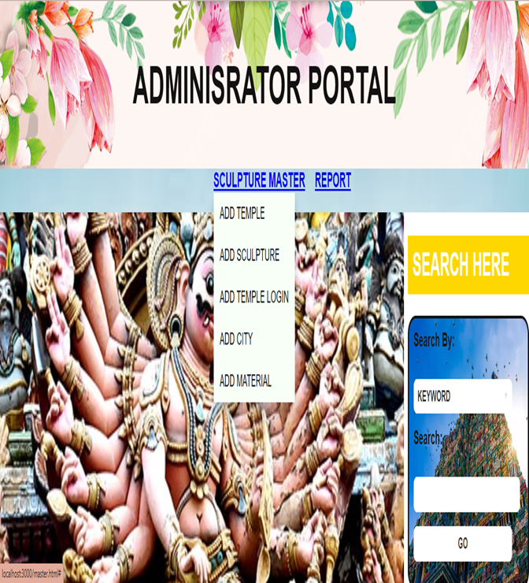
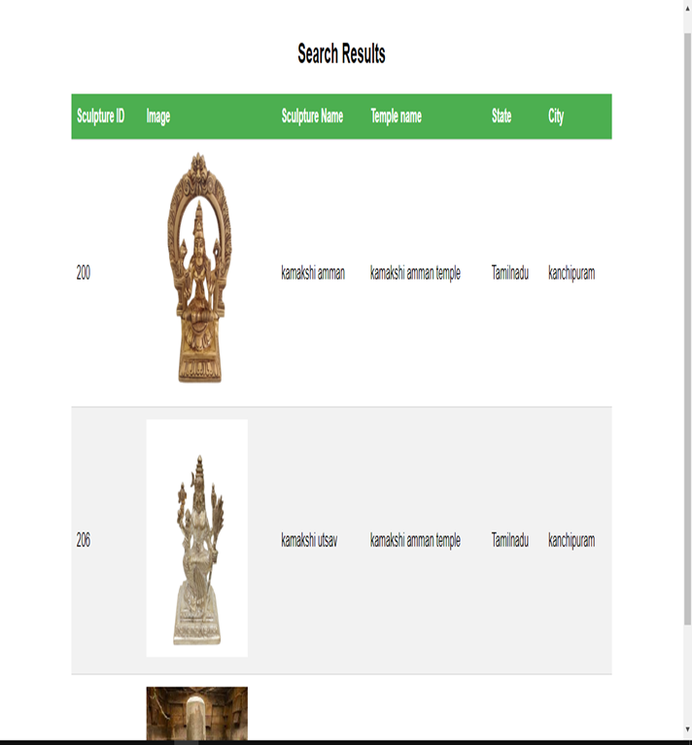

Slide 17
Conclusion
A search engine for sculpture management can be a valuable tool for Police department and other temple authorithy in the field of sculpture. Such a search engine would allow users to easily find and compare information about different sculptures, including their history, provenance, and current location. Additionally, it could help to streamline the process of managing and tracking sculptures within a collection, making it easier to keep track of important details such as conservation needs and exhibition history. Overall, a sculpture management search engine has the potential to greatly enhance the accessibility and organization of information related to sculptures. However, if the sculpture is identified as belonging to a temple, it is likely that further research could be done to trace its history and cultural significance.
*

Slide 18
References
*

Slide 19
Future Reference
[1]. Krishna Kumar Pandey1 , Nishchol Mishra2 ,Hemant kumar sharma Enhanced of color matching algorithm for image retrieval IJCSI International Journal of Computer Science Issues, Vol. 8, Issue 3, No. 2, May 2011.
[2]. V.S.V.S. Murthy, E.Vamsidhar, J.N.V.R. Swarup Kumar “Content Based Image Retrieval using Hierarchical and K-Means Clustering Techniques “ 2010.
[3]. Sangoh Jeong, “Histogram-Based Color Image Retrieval”, 2001

Slide 20
Thank You
*

